Slide 1


ECEN 404 Final Presentation Team 30: ECEN 215 Lab Kit Members: Luis Diaz-Santini, Yusuf Hossain,
Ryan Freed, and Peter Zhang Sponsor: Dr. Lusher
TA: Garret Brown

Slide 2
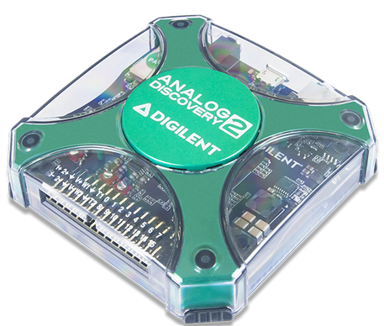
Project Summary
Problem Statement:
Principles of Electrical Engineering (ECEN 215) teaches the basics of electric circuit analysis and electronics to non-ECEN majors.
The transition of ECEN 215 to an online format poses a challenge due to its lab component relying on the Analog Discovery 2 (AD2), which is expensive.
Solution Proposal:
The ECEN 215 Lab Kit offers a solution to the cost, convenience, and over complication issues that are abundant with the AD2. Aiming for a $50 price point, the lab kit offers a more catered simpler approach to each lab while also making it possible to complete at home.
Will operate as the power supply, signal generator, multimeter, and Oscilloscope.

Slide 3
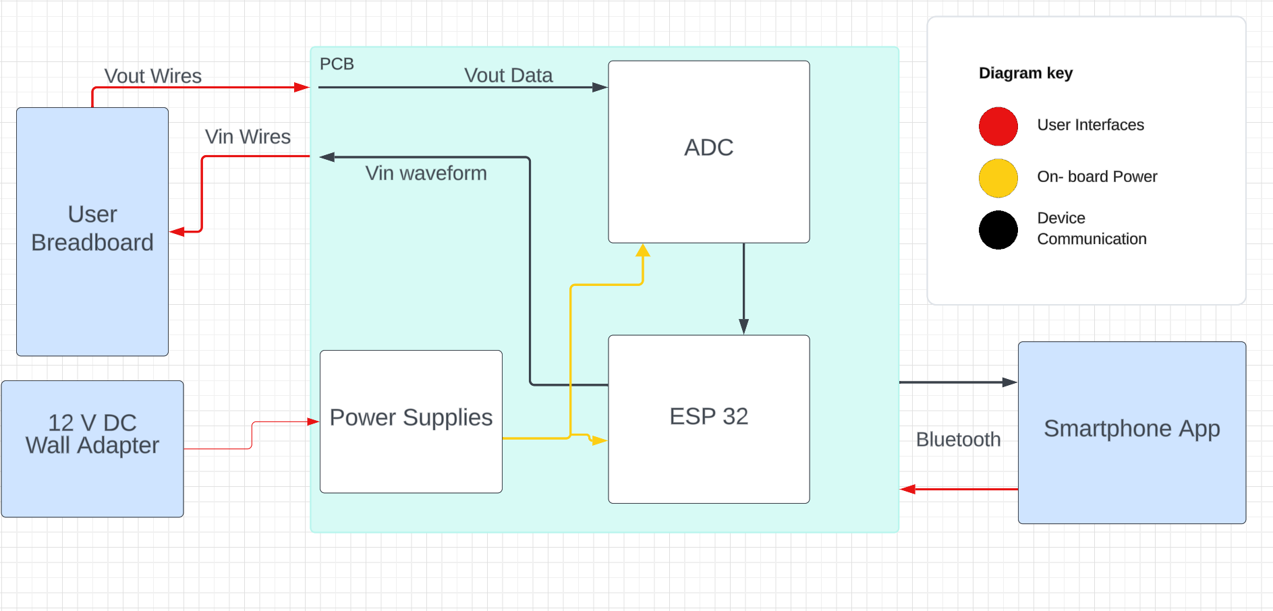
Subsystems Overview
Peter: Multimeter and Oscilloscope
Yusuf: Waveforms and communicating to the microcontroller
Luis: Mobile application to interface with device
Ryan: PCB design and power

Slide 4
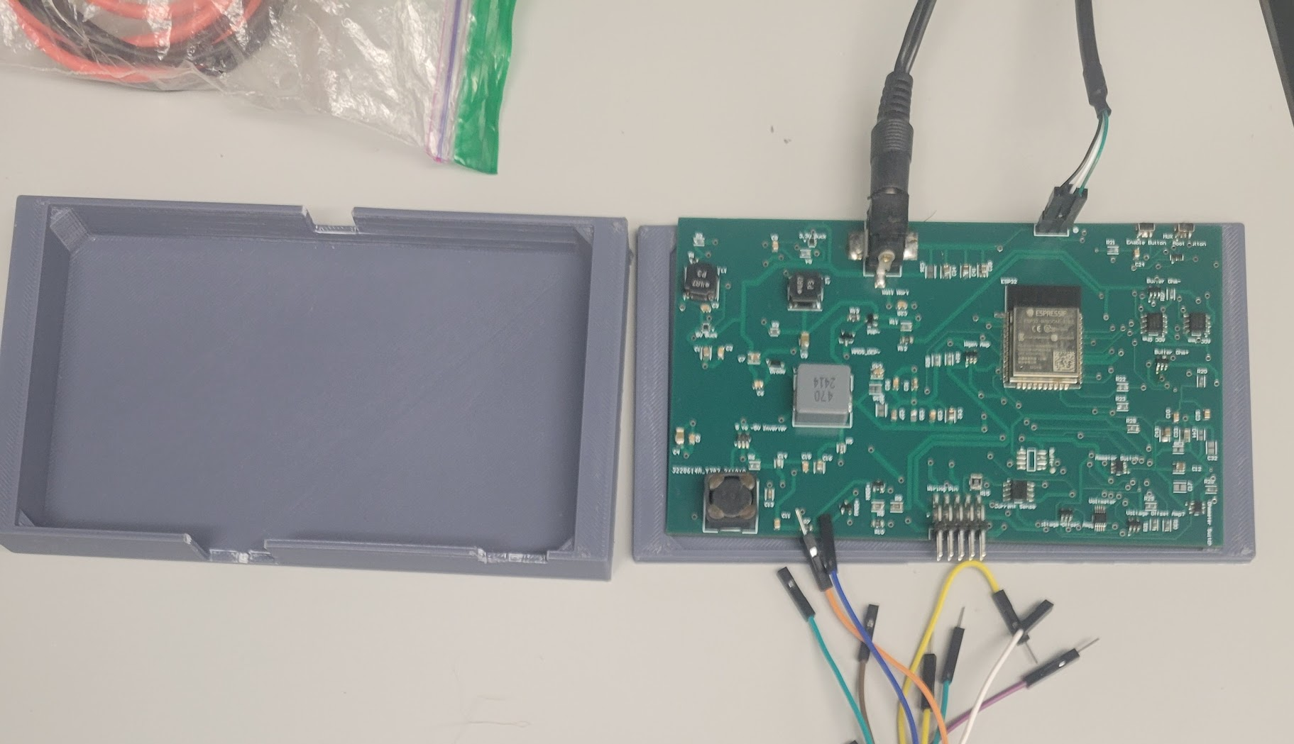
Integrated System Diagram
Pins:
5 V supply(+-)
GND
Waveform
Amm(+-)
V(+-)
Ohm(+-)

Slide 5
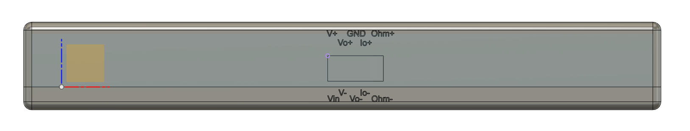
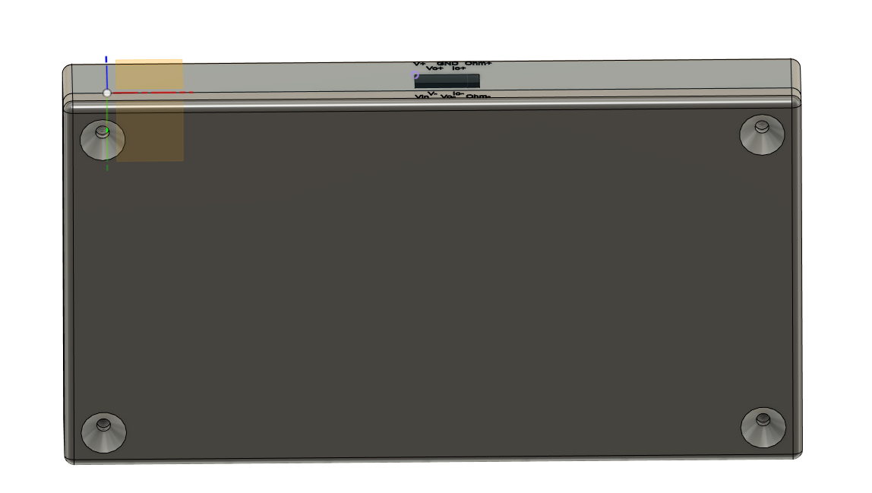
Integrated System Diagram

Slide 6
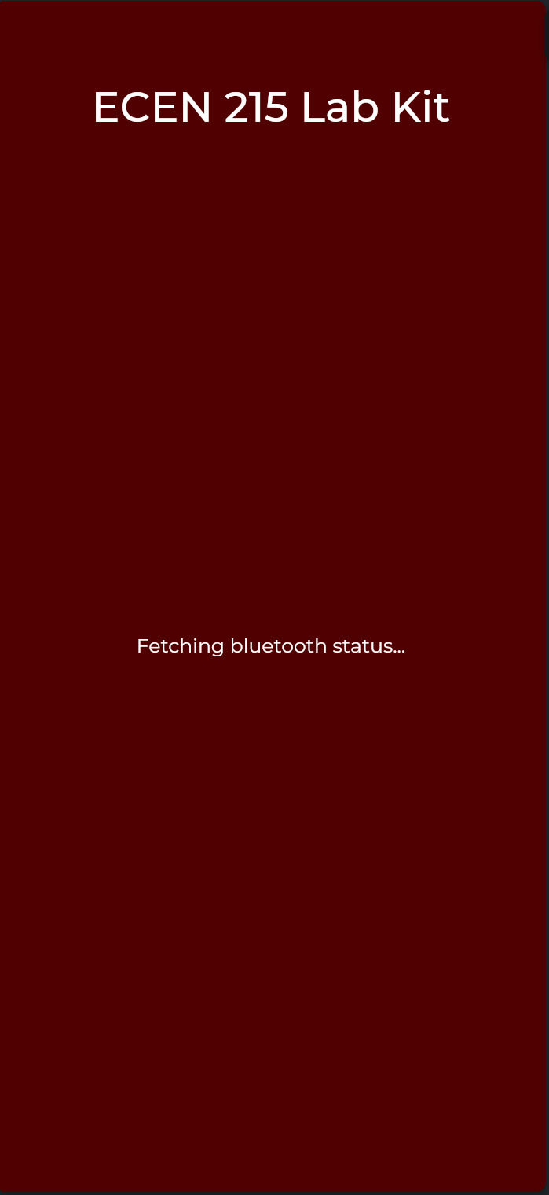
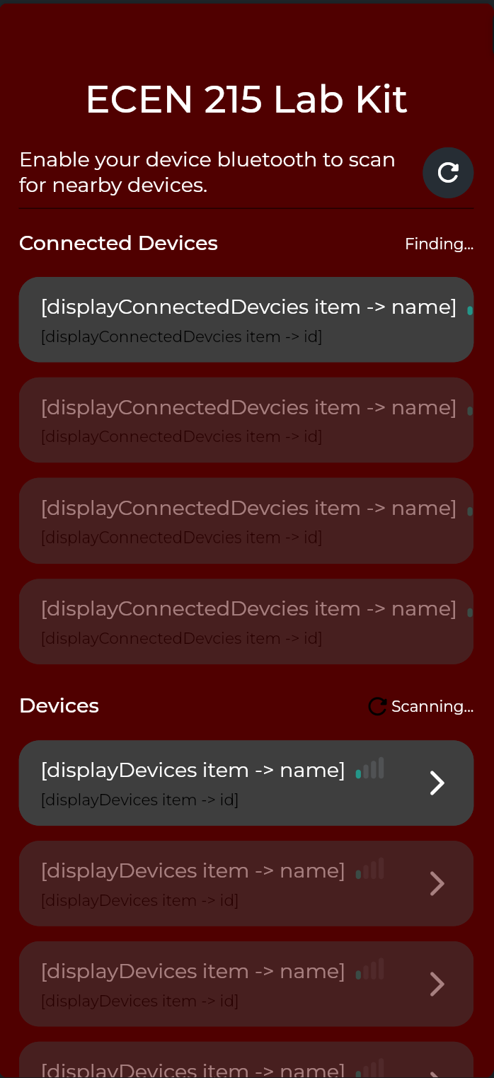
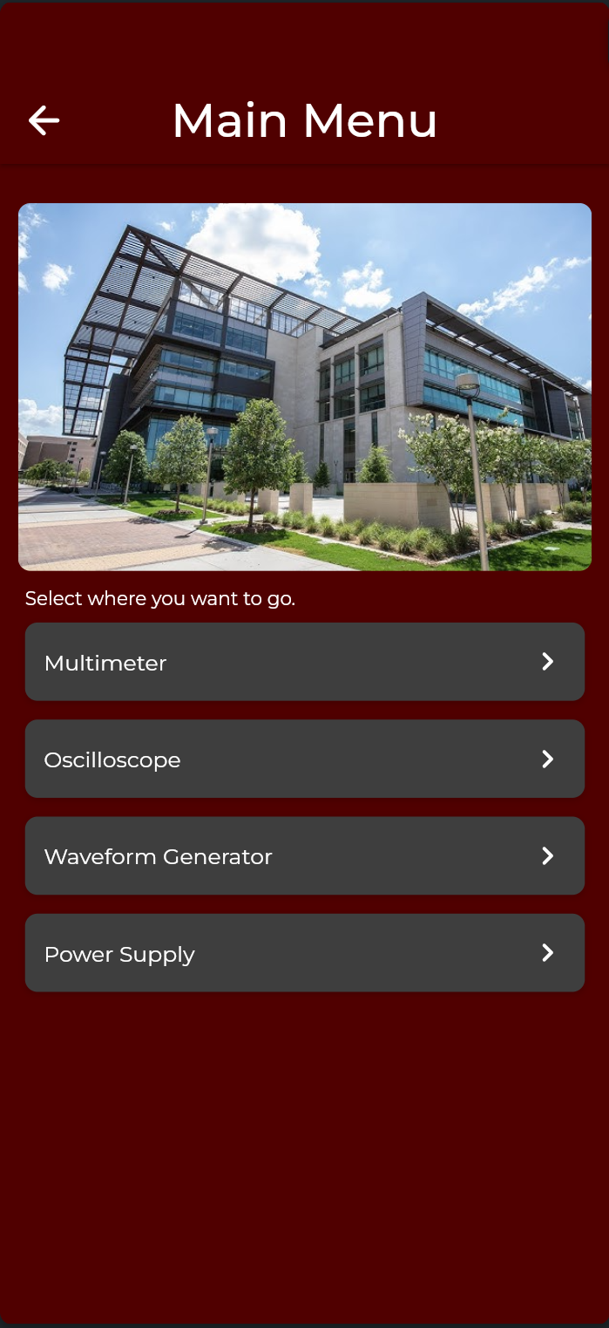
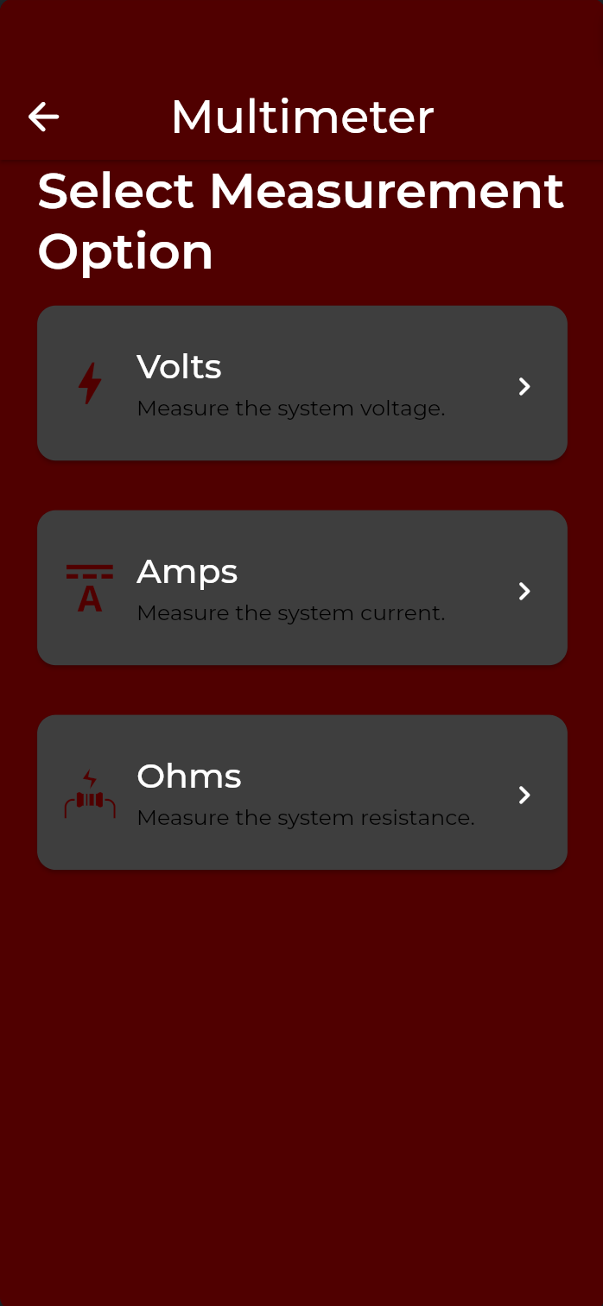



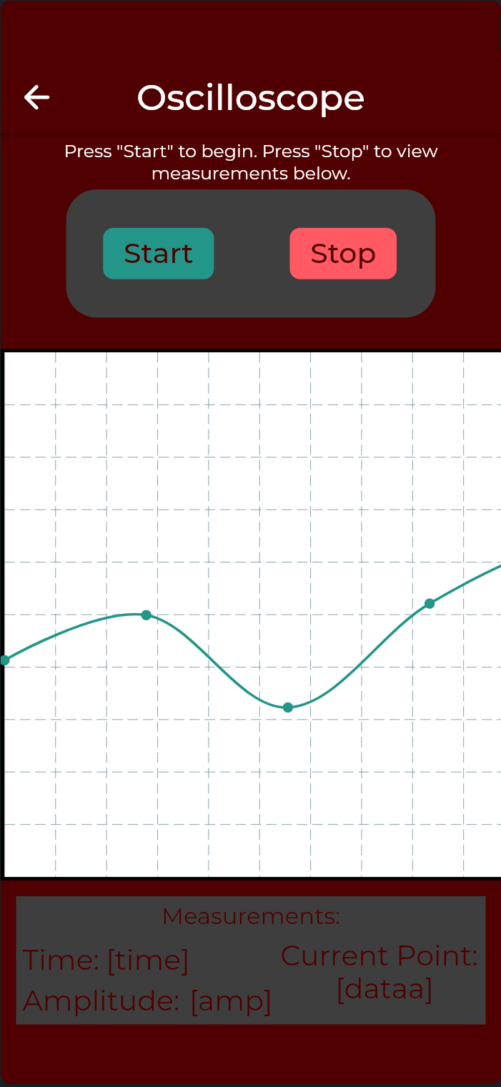
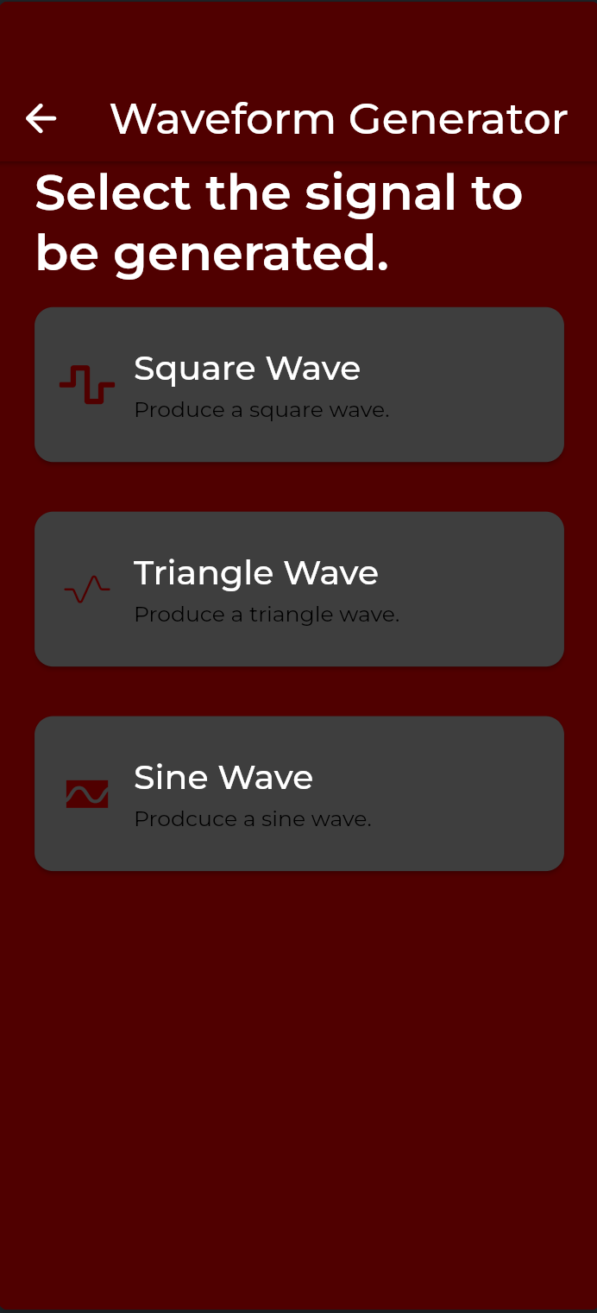
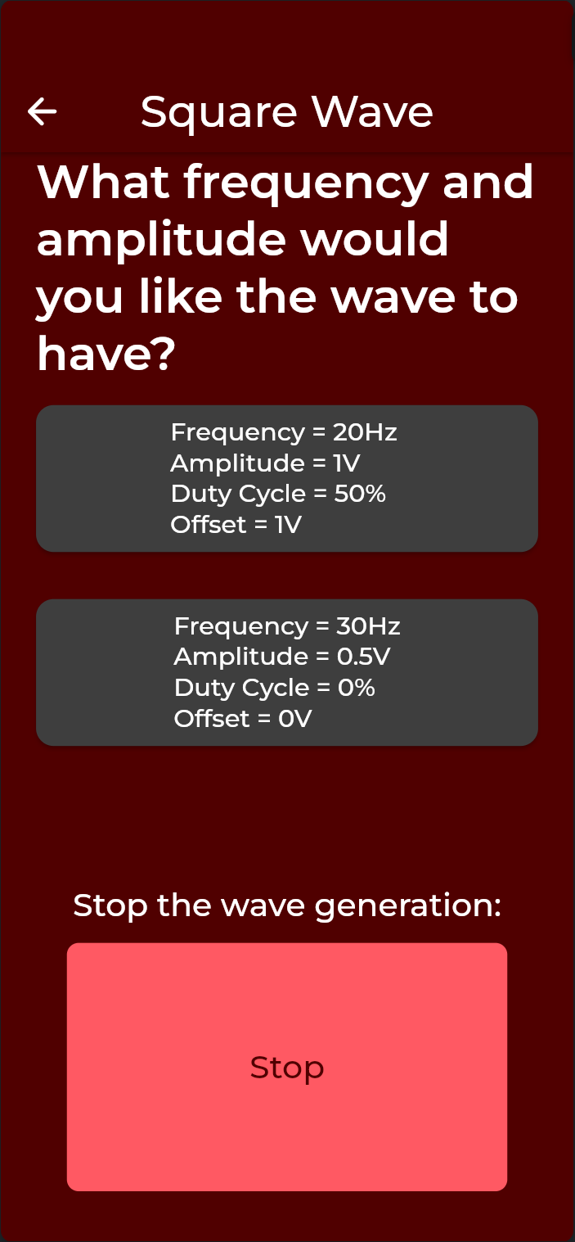
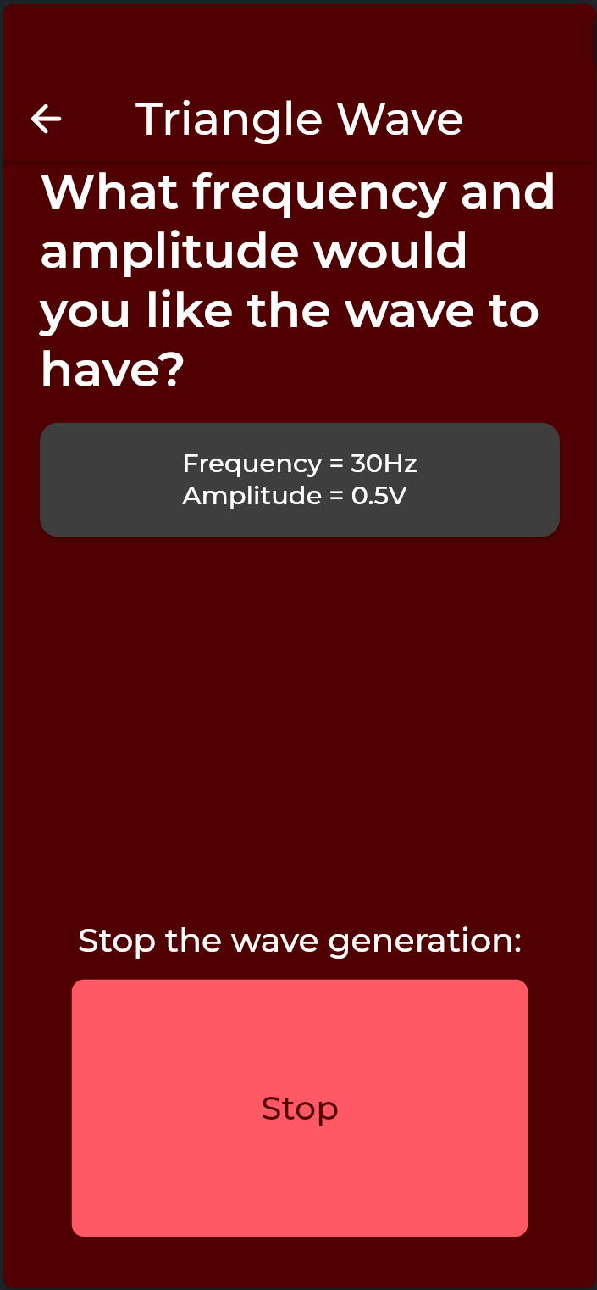
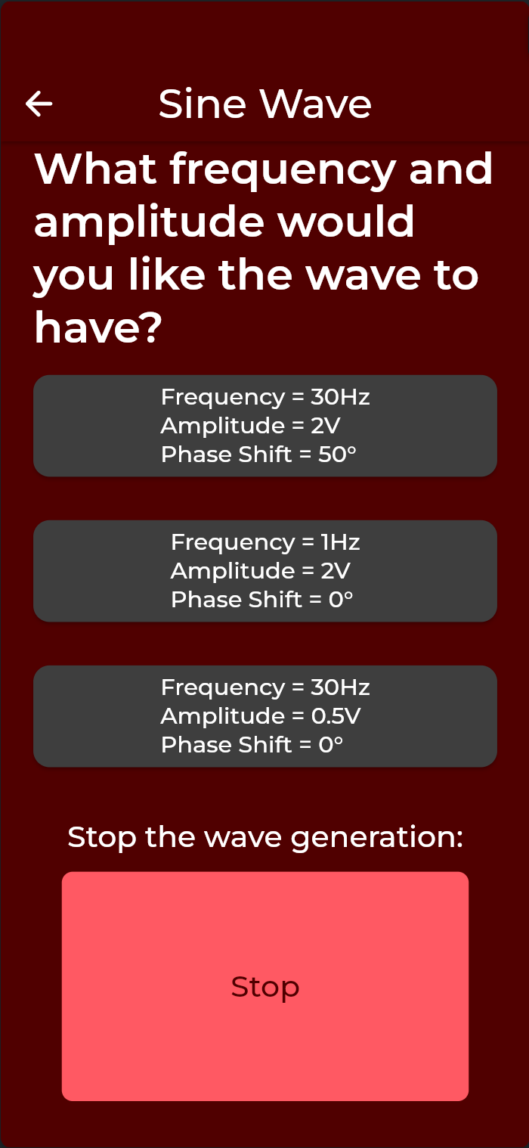

Integrated System Diagram

Slide 7
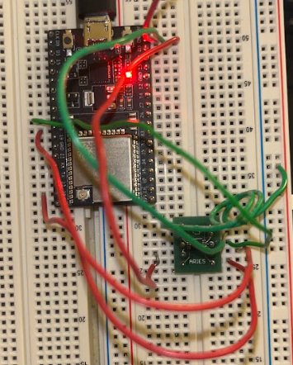
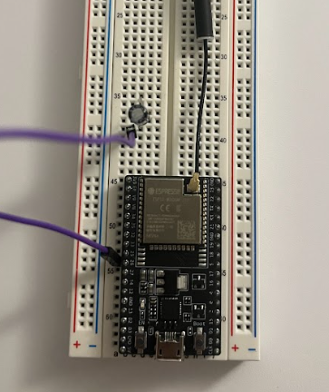
Waveform Generator
Yusuf Hossain1
Accomplishments:
Design wavegen function(Sine, Triangle, Square)
Modify shape and parameters of waveform
Transfer Data to App via BLE
Challenges:
Bluetooth communication with mobile app
Centering graph along 0v
Preventing watchdog timer from triggering

Slide 8
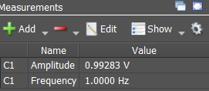
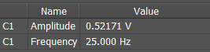
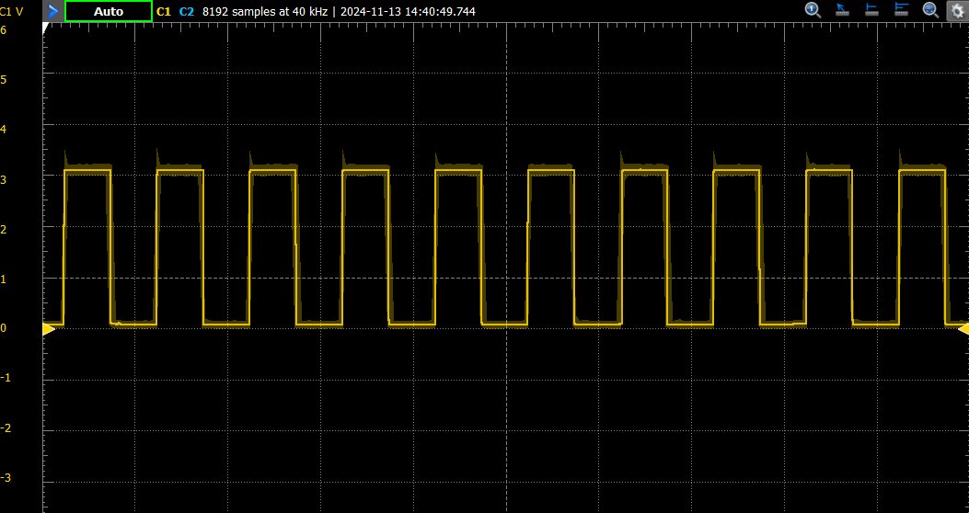
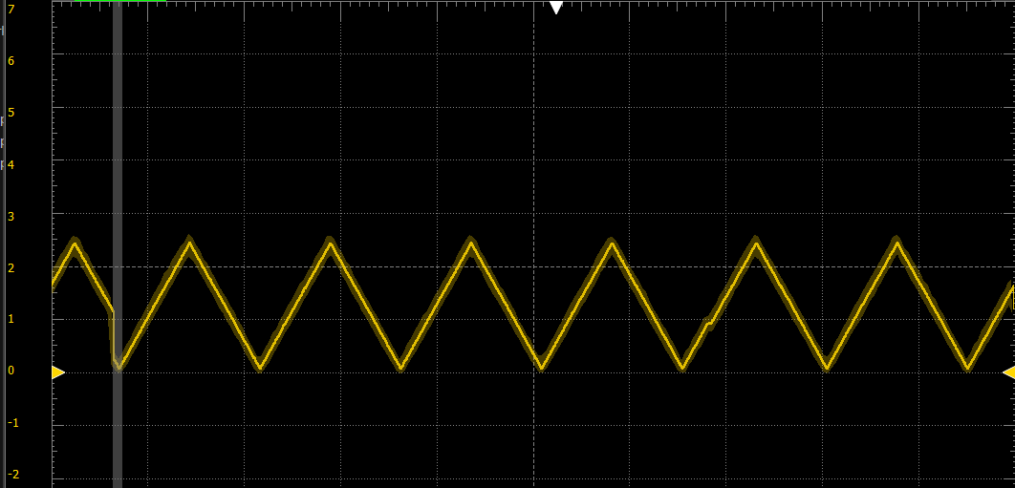
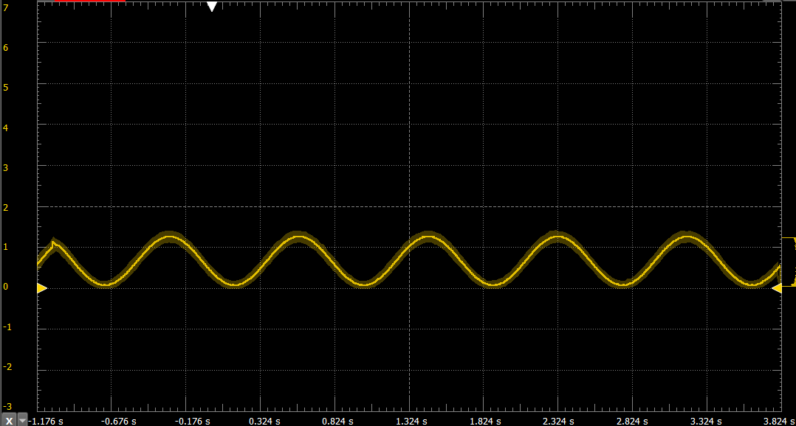
Waveform Generator
Yusuf Hossain
Validation:
Test | Success Criterion | Results
Wavegen Shapes | Produce Sine, Triangle and square waves
Amplitude | 0.5V, 1V, and 2V
Frequency | 1 Hz, 20 Hz, and 30Hz
Wavegen Noise | Output signal is moderately accurate

Slide 9
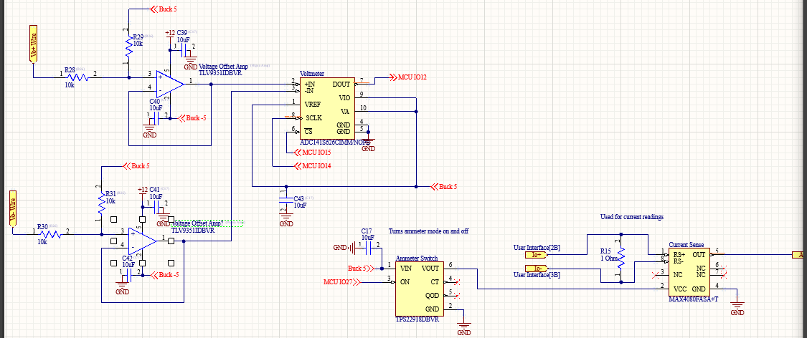
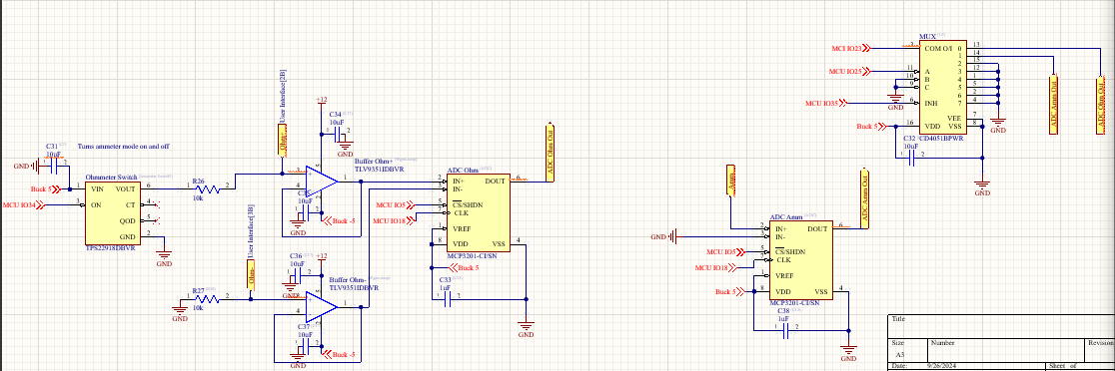
Oscilloscope and Multimeter
Peter Zhang
Accomplishments:
Design Multimeter (Ammeter, Ohmmeter, Voltmeter)
Design Oscilloscope
Read and Modify Data via ESP32
Transfer Data to App via BLE
Challenges:
Real time Oscilloscope Graph at high frequencies

Slide 10
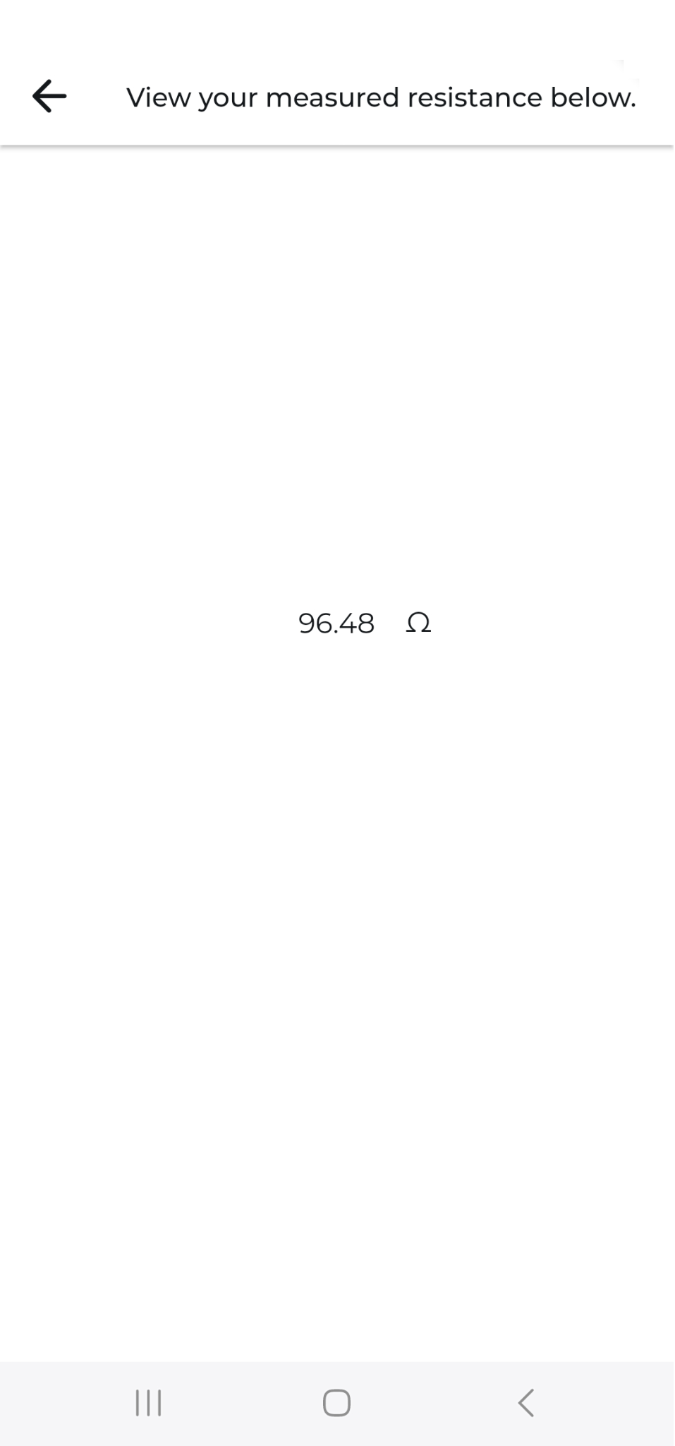
Oscilloscope and Multimeter
Peter Zhang
Validation:
Test | Success Criterion | Expected Value | Measured Value | % Error
Ammeter Functionality | Capable of reading 0.5 A of current | 0.5 A | 0.46924 A | 6.15%
Ohmmeter Functionality | Capable of reading an 100 ohm resistor | 100 ohms | 96.48 ohms | 3.52%
Ohmmeter Functionality | Capable of reading a 10000 ohm resistor | 10000 ohms | 9861 ohms | 8.861%
Multimeter | Capable of reading 0 V | 0 V | 0.0013 V | 13%
Multimeter | Capable of reading 2.5 V | 2.5 V | 2.682 V | 7.28%
Multimeter | Capable of reading 5 V | 5 V | 4.730 V | 5.4%
Oscilloscope | Capable of reading a sine wave | - | - | -

Slide 11
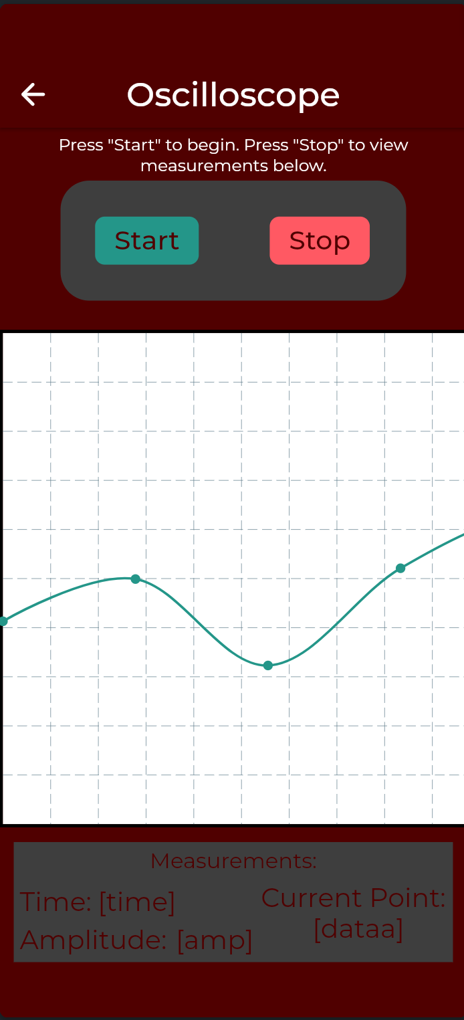
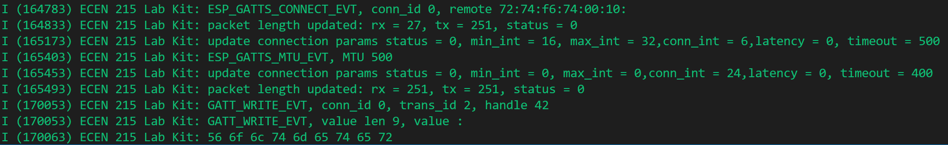
Mobile App
Luis Diaz-Santini
Accomplishments:
App Design/GUI
BLE integration with ESP32
Multimeter Readings
Live Oscilloscope Graph
Waveform Generation
Power Supply Activation
Challenges:
Integration of BLE communication with ESP32
Live Oscilloscope Graph

Slide 12
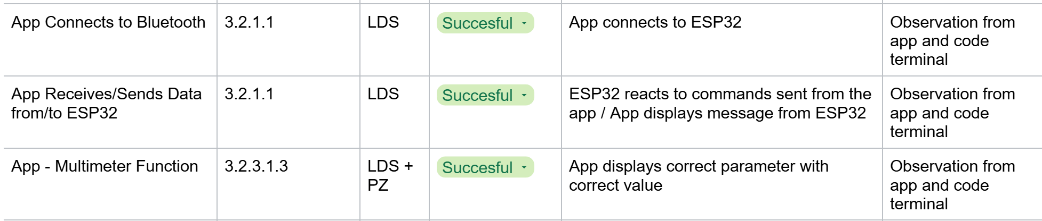
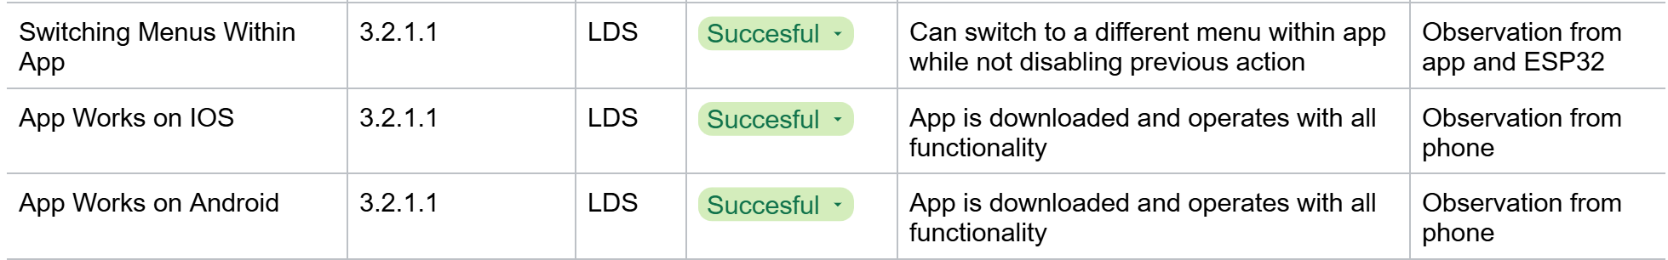
Mobile App
Luis Diaz-Santini
Validation:
Video showcasing full app functionality:
https://drive.google.com/file/d/10UdYCeHDuIcj6uwE935X0WxXNMVjO5qH/view?usp=sharing

Slide 13
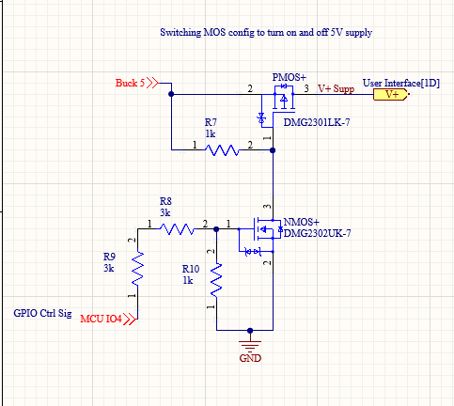
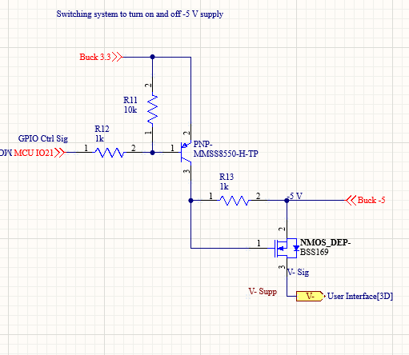
PCB and Power
Ryan Freed
Accomplishments:
Designed Buck Converters
(5, 3.3, and -5 V)
Designed Power Supply
switching system (5 and -5 V)
Designed PCB and case
Low price and size
Challenges:
Oversee final integration onto PCB
-5 V supply switch holds -5 V

Slide 14
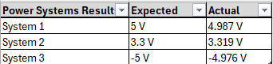
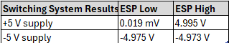
PCB and Power
Ryan Freed
Validation:

Slide 15
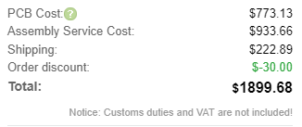
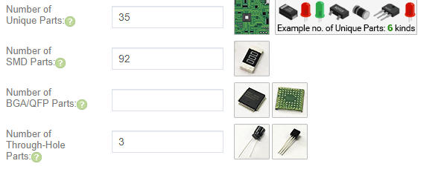
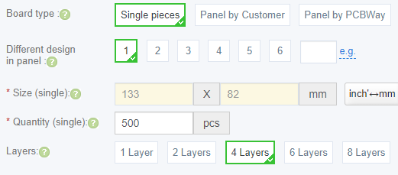
PCB and Power
Ryan Freed
Validation:
Altium Price Analysis: $44.57
JLC Price Analysis per 500: $3.80
Wall Adapter: $8.83
Overall Estimate: $57.20 per board
Case Size: 156.7x85.6x21.7mm
Area increase vs. phone: 24%

Slide 16
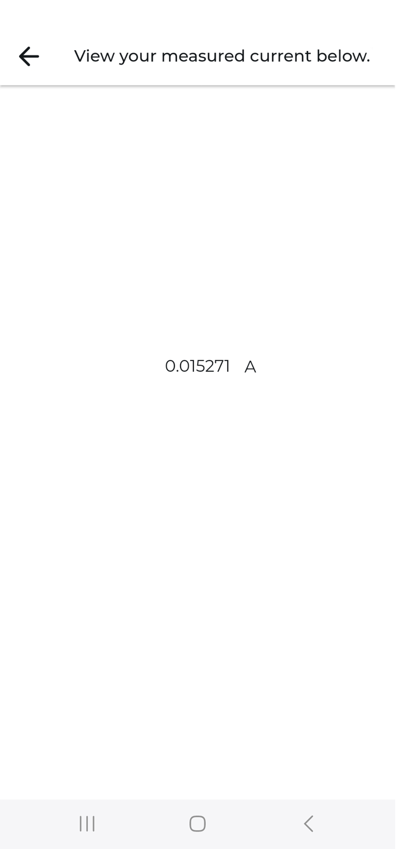
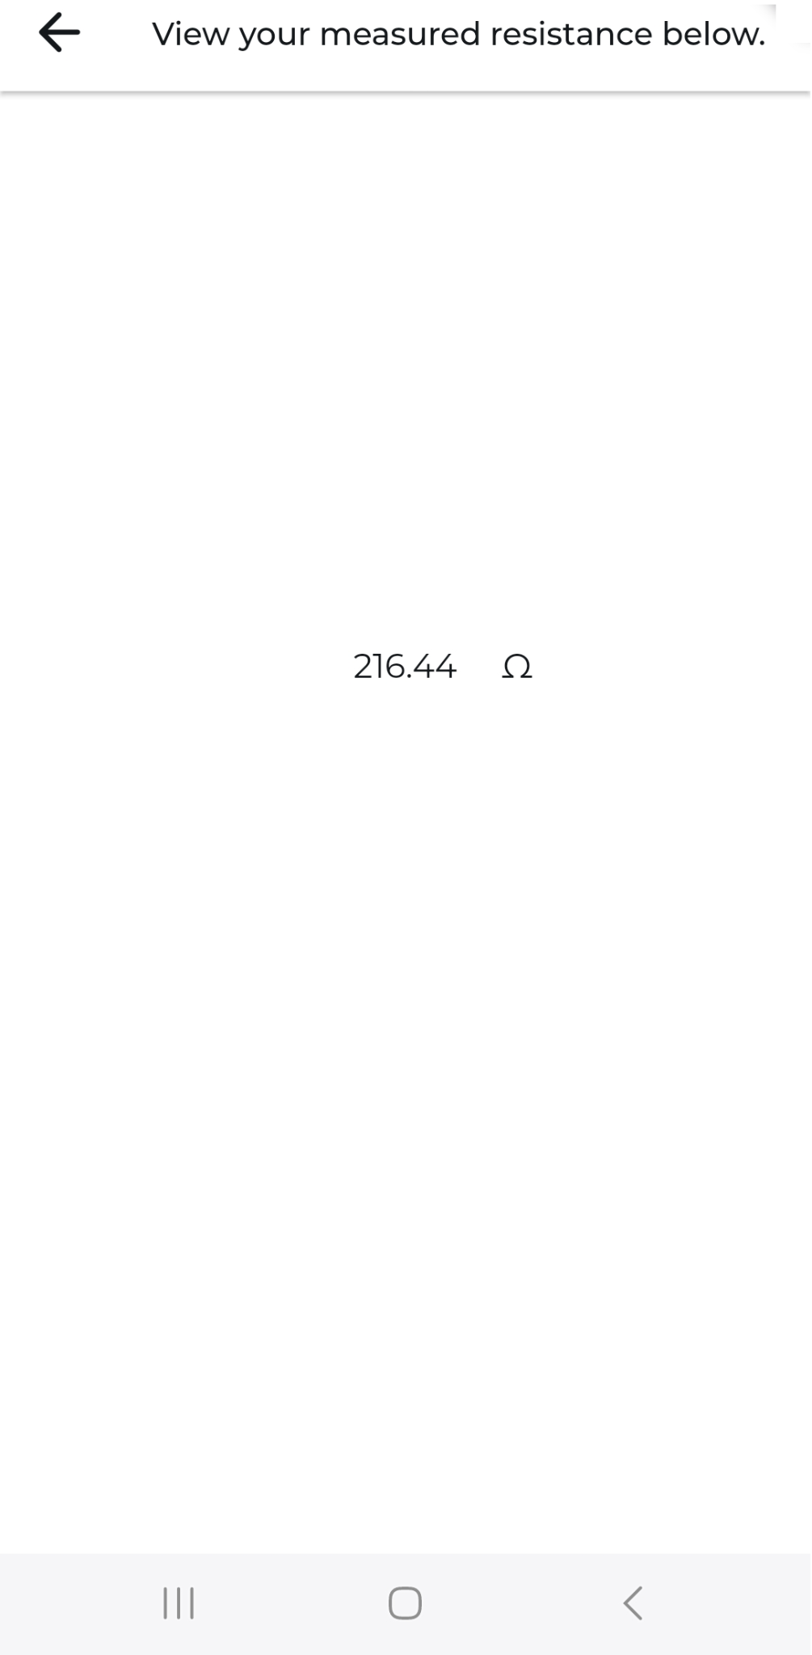
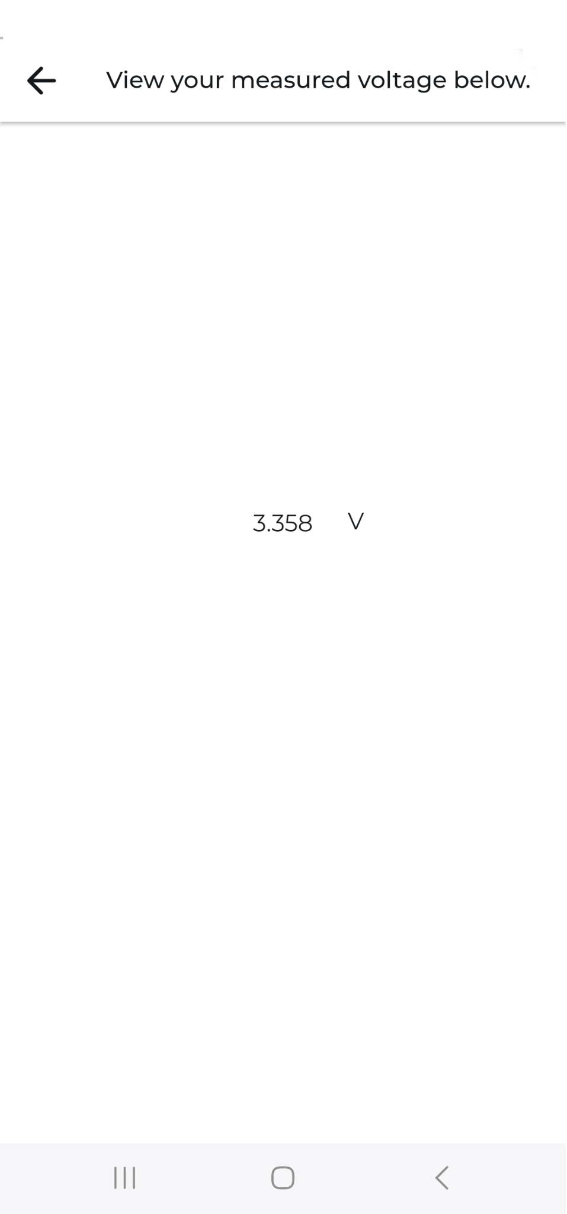
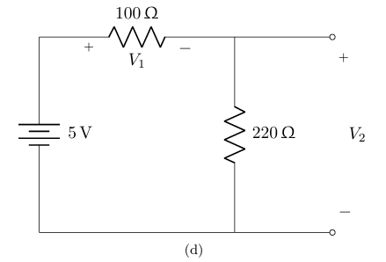
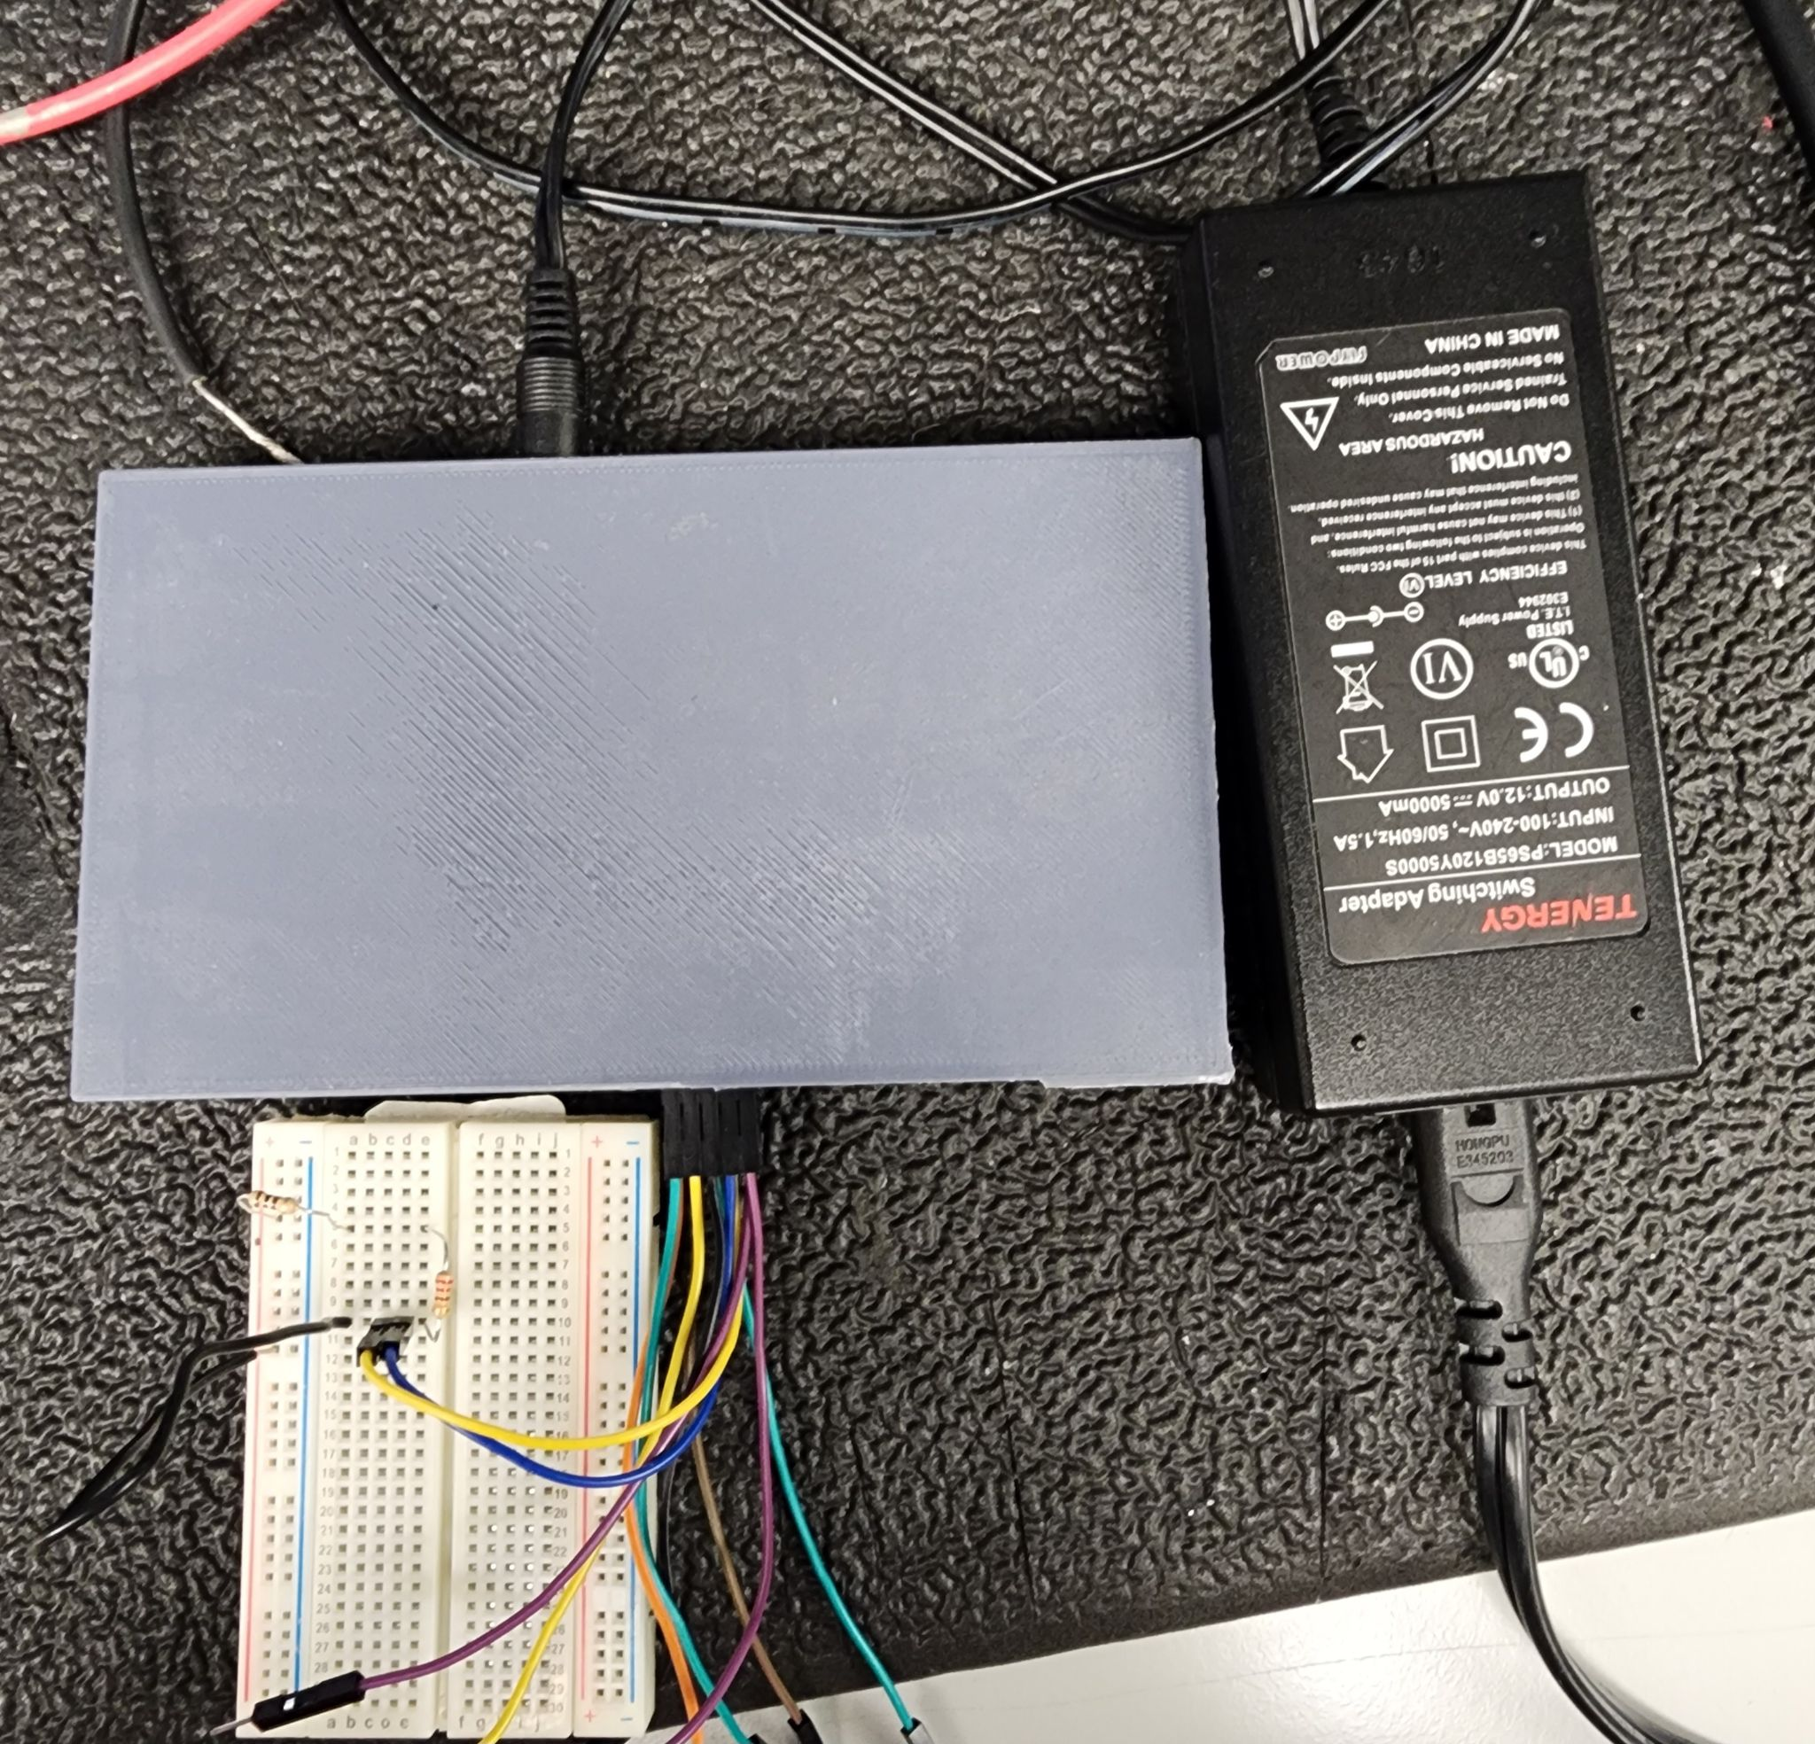
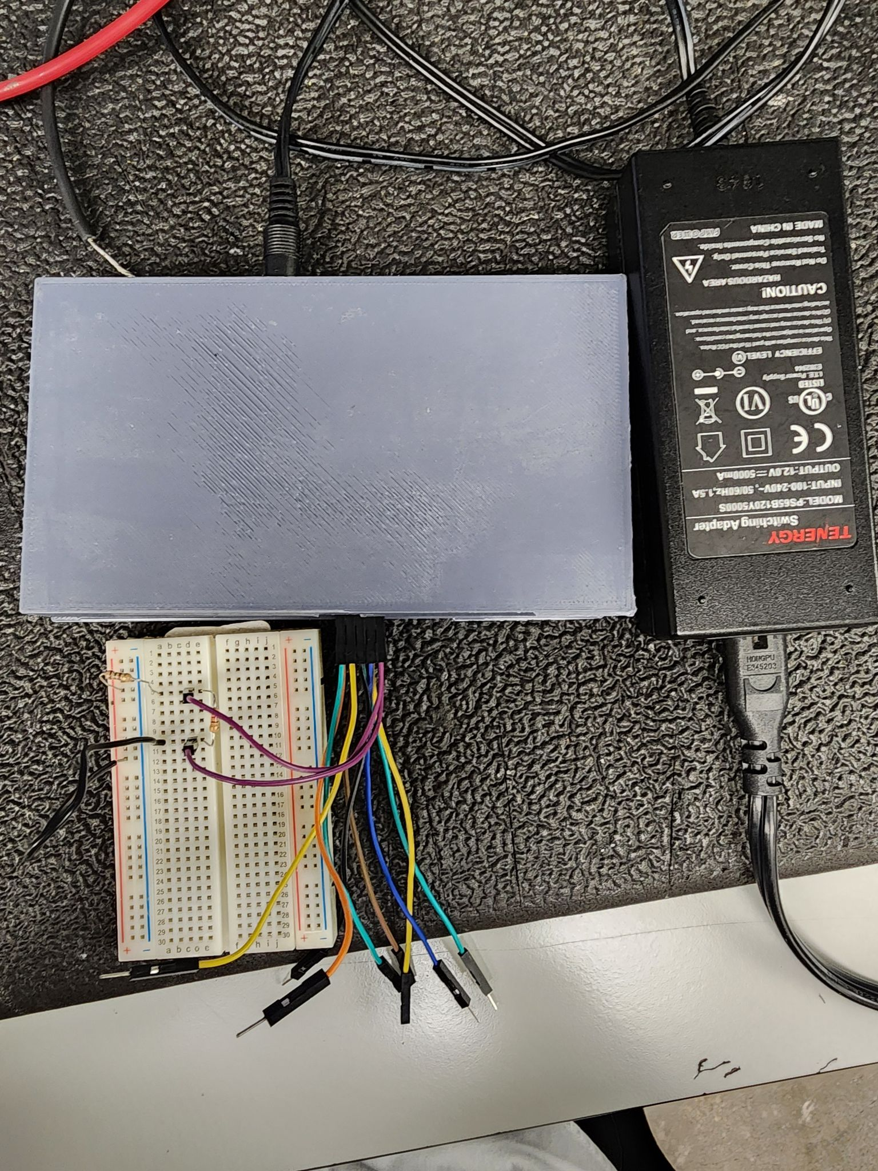
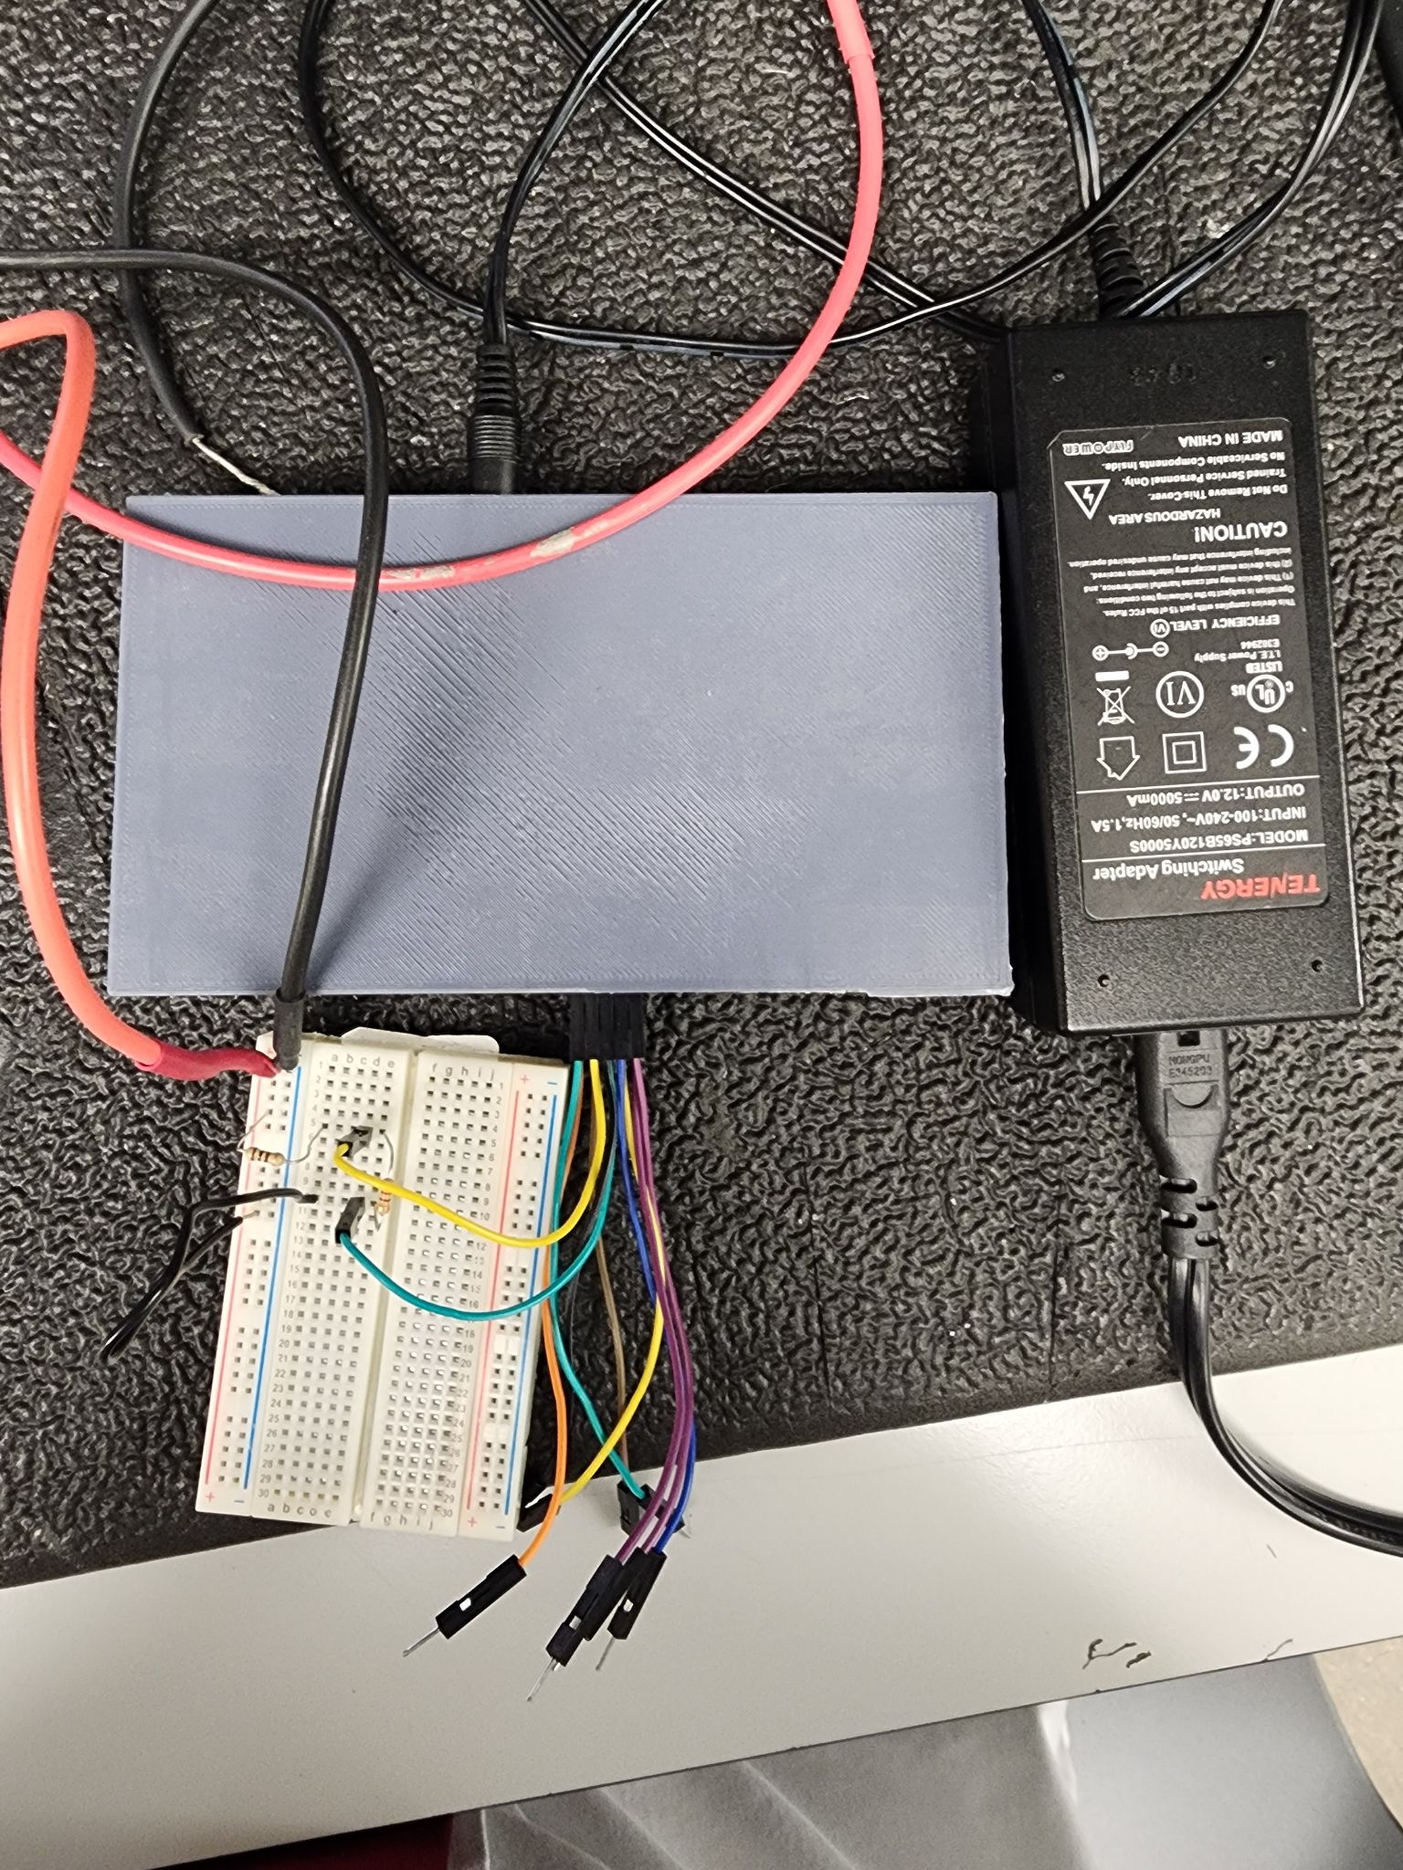
Integrated System Results
Ammeter
Ohmmeter
Voltmeter
Lab 1 Ohm’s Law and Kirchhoff's Law

Slide 17
Integrated System Results
Waveform Generator, App, and PCB:
https://drive.google.com/file/d/1HsJdlkcoqY8s2VR6HYMTjCI4jrrvhMAs/view?usp=sharing

Slide 18
Conclusions
Overall system remain mostly unchanged except for ADC and multimeter system.
Altered the ADC’s bi-polar input design
The ohmmeter and ammeter each have respective ADC’s
Current status:
All individual systems functioning
Multimeter, wave generator, and power supply are fully operational with app input
Oscilloscope messaging from ESP32 to be done in 1 week
Wavegen capacitor and ADC buffer amp to be added by tomorrow to facilitate negative waveforms and protect ADC

